Slide 1
Top-K list Extraction
Zhang Zhixian
Wang Zheng
Kenny Zhu
Haixun Wang
Notes:
Hello everyone, today I'd like to introduce our work on top-k list extraction and the current state of this project.

Slide 2
Top-K Page/List
Definition
A Top-K page is a page solely about 1 Top-K list.
A Top-K list is a list of K instances of a topic or a concept.
Example
Top 10 Beaches in the World
5 Hollywood Classics You Shouldn’t Miss
50 tallest people in the world
Notes:
First of all, I want to introduce top-k page and top-k list. Here is the definition of these two terms.
A Top-K page is a page solely about 1 Top-K list. And A Top-K list is a list of K instances of a topic or a concept.
So when you guys surf the internet, you may see some page with a title such as Top 10 NBA players, then you will know this page should give a list of 10 items and the list items are all about NBA players. So this page is a top-k page--actually it is a top-10 page, and the list in this page is a top-10 list.

Slide 3

Typical Example: Features
Noise List
Page Title
Top-K List
List Item
Notes:
Now let's look at one example page and see some features of top-k pages.
This is part of a top-k page. We can see this is the page title, essentially it should contain list item count K, in this case it should be 20.
This is the top-k list and this part should be one list item. So a list item is a block of the whole page. It may contain some components like a picture, the title of this item and some description.
Also I must mention that it is normal for a top-k page to contain other noise list such as advertisements and comments and it is possible that the count of noise list also equals to K. Later on you will see that sometimes it will be quite confusing.

Slide 4
Potential Application
Fact Search
Knowledge Base
Notes:
OK now you know what a top-k page is but you may wonder why we are interested in such kind of pages. Here I list two potential applications of top-k page.

Slide 5
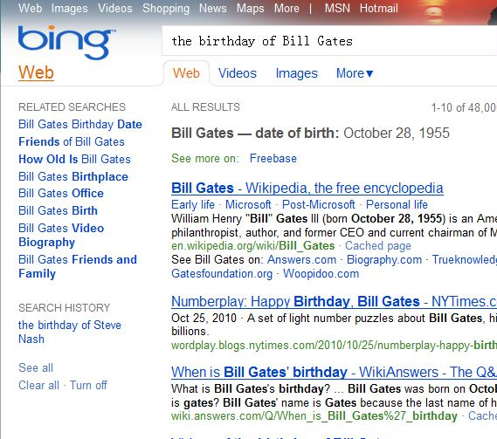
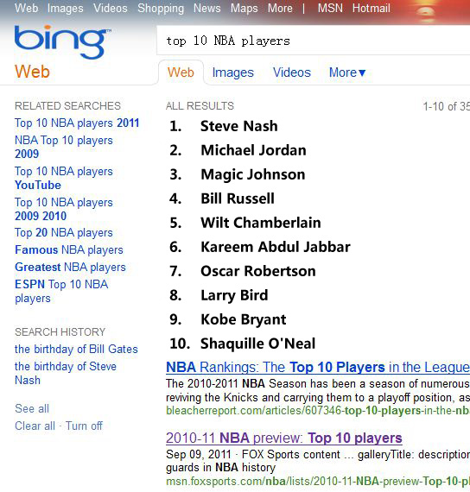
Fact Search
Birthday Search
Ranking List Search?
Notes:
First is fact search. So What is a fact search? Here is an example: birthday search: if you search the birthday of Bill Gates, you can get the date directly from the search engine, not from some pages about Bill Gates.
We can do sth similar, that is, a list search, this picture is not real, I just PS it. You know steve nash will never be the best one right? But anyway it gives the idea of ranking list search, if we can get info from top-k pages and top-k lists, maybe it will come true.

Slide 6
Knowledge Base
10 Tallest Buildings
Taipei 101
Petronas Tower
Sears Tower
Jin Mao Building
International Finance Centre
CITIC Plaza
Shun Hing Square
Empire State Building
…
ProBase
Concept-Instance Pairs
Animal-Dog
Instance Inferring
Notes:
Another potential application is about knowledge base. One famous knowledge base is ProBase, from Microsoft Research. Generally it contains a lot of concept-instance pairs, such as animal and dog--here animal is a concept while dog is an instance. With the help of top-k lists we can do instance inferring. For example, this is a list of tallest buildings, if we already know building is a concept, then we can infer that all the list items: Taipei 101 Jin Mao Tower are all instances of buildings.

Slide 7

Our Goal
Detect & Extract Top-K List
1
2
3
…
List
Extraction
System
Notes:
So this is the project goal: we want to design an automatic system that can extract top-k lists from web pages.

Slide 8
Road Map
Analyze the title
Top-K Page Identification
Info Extraction: K, Concept…
Analyze the content (List Extraction)
Basic Algo
Optimization
Application
Notes:
This is the road map of our project.
First we need to analyze the page titles.
We want to know whether or not this page is a top-k page. If so we can some infomation from the title, like the number K, the concept of the list and so on.
Second we need to extract the list from the page content. We have a basic algorithm based on tag path and some optimizations based on visual cues.
Finally we will think about its application.

Slide 9
List Extraction
Problem
Given a top-K page and number K, find the top-k list.
Notes:
But in fact we do not follow this road map, actually my work this summer are mainly on the second part.
This is the problem definition of list extraction. Since this is the second step in the whole road map, we just assume that we have got the correct number k from the title, and this page is a top- k page.

Slide 10
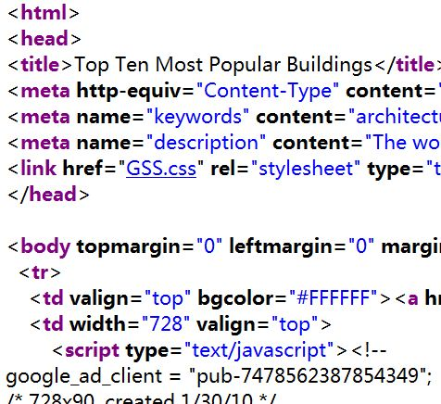
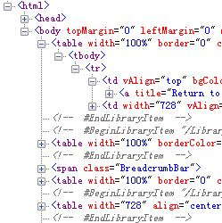
Tag Path
HTML
DOM Tree
Tag Path
/html/head
/html/body/
/html/body/table
…
/html/…/td/a
…
Notes:
Before we see the algorithm, let's look at the tag path. Originally what we get is a HTML page like this. It can be converted into a tree stucture called DOM Tree, each node in this tree is a HTML tag and a tag path is the path from the root node-here it should be html-to the tag node we are interested in. Here are some examples of tag paths.

Slide 11
Basic Algo
Property
The list items of one Top-K list share the same set of tag paths.
Notes:
Therefore, the basic algorithm is mainly based on such a property: The list items of one Top-K list share the same set of tag paths.

Slide 12
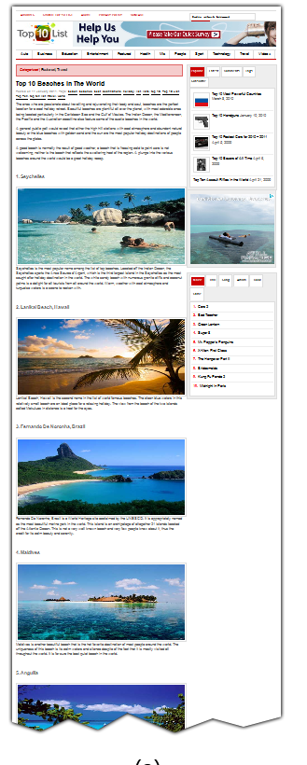
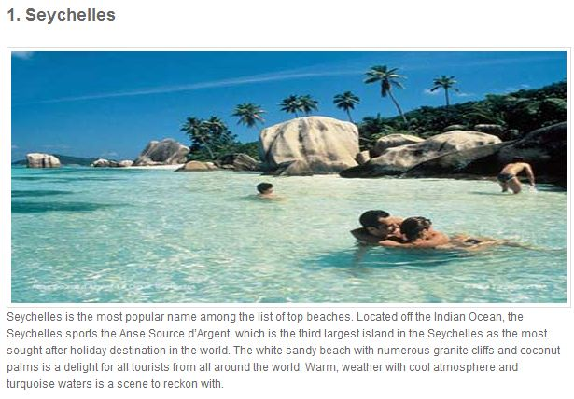
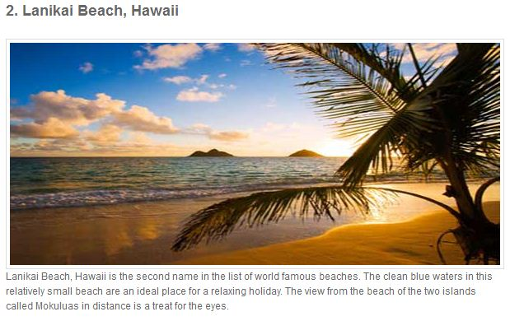
Basic Algo: Example
/html/
/html/head/
/html/body/
…
…
/html/body/…/p/strong/
/html/body/…/p/pic/
/html/body/…/p/
…
…
Notes:
This example can describe this property:
This is a top-k page.
These are some tag paths of this page.
This is one list item. What is the tag path of this? This one!
For another item the tag path of title is also this one.
For the same reason, all the pictures of list items share this tag path.

Slide 13
Basic Algo
Property
The list items of one Top-K list share the same set of tag paths.
Steps
Tag Path Clustering
Candidate Check
“Grow Up”
Result Selection
Notes:
So based on the property, we design the basic algo.
It has four steps:
Tag Path Clustering
Candidate Check
“Grow Up”
Result Selection

Slide 14
Basic Algo:Step1 &2
Tag Path Clustering
Candidate Check
Count=K?
Tag Path | Count
/html/ | 1
/html/body/ | 1
…
/html/body/…/div | 4
/html/body/…/div/p/ | 23
…
/html/body/…/p/strong | 10
/html/body/…/p/pic | 10
…
Notes:
Step 1 and 2 are quite simple. We do clustering to all tags and maintain such a table, one is tag path, another is the count of the tag path.
Then we check them one by one to see whether or not they are candidate tag paths. The rule is very simple, we just check the count, if it equals to K it will be considered as a candidate. Otherwise we remove it.

Slide 15
Basic Algo: Grow Up
Problem description
Candidate Tag Path | Count
…
/html/body/…/p/strong/ | 10
/html/body/…/p/pic/ | 10
/html/body/…/p/ | 10
…
Notes:
With all candidate tag path, we come to this process, grow up. This is a example to describe the problem, in the list item, the title's tag path is this. The picture's tag path is this. But what we want is the tag path of the whole item, that is this one. So we should infer the item tag path by the tag paths of its components.

Slide 16
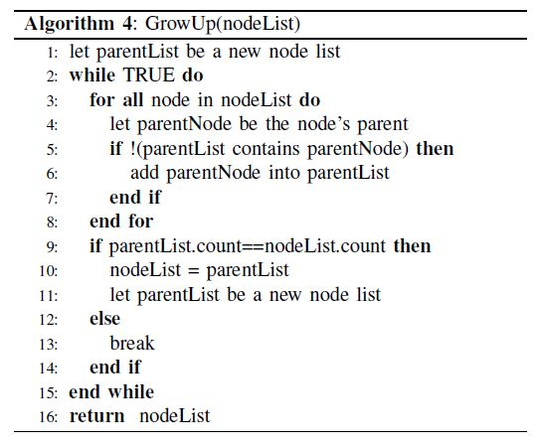
Basic Algo: Grow Up
Our solution
For a node list that is corresponding to a candidate tag path, find their parent node list and check whether those parent nodes are separated.
Notes:
This is the solution of this problem. The picture shows the persudo code of the algorithm.
For a node list that is corresponding to a candidate tag path, find their parent node list and check whether those parent nodes are seperated.

Slide 17
Basic Algo: Grow Up
html
div
/html/…/div/
p
/html/…/div/p/
Strong
/html/…/div/p/strong
pic
/html/…/div/p/pic/
Notes:
This example may give you a better image. As you see, this is a DOM Tree. These are tag paths. So for these tags, we try to find the parent node for each of them so this set of nodes can grow up to this set of nodes. We can keep doing this process until the parents are not separated. In this case we cannot grow up any further because you see some of the nodes share one parent. By the way, another function of this process is to reduce the total number of the candidates, just like this set of nodes, they will also become this set after this process. So we can just keep one of them.

Slide 18
Basic Algo: Result Selection
One tag path left? Good.
Multiple tag paths—Choose the main list
Entropy
Text length
Visual area
Notes:
At last, we must pick one candidate tag path as the top-k list.
If at that time we only have one tag path, things will be simple.
But if not, we have to choose the main list. I list several ways to rank the importance. And finally we use visual area.

Slide 19
Result Selection: Visual Area
The actual area occupied by a HTML node
The larger visual area, the more important
Notes:
Generally speaking, the visual area is The actual area occupied by a HTML node. And we assume that visual area is related to the importance. The larger the more important.

Slide 20
Basic Algo
Tag path clustering
Candidate Check
Grow Up
Result Selection
Notes:
OK So much for the basic algo, the idea is very simple but the performace is not very satisfying.

Slide 21
Optimization
Interleaving Problem
K+1 Problem
Tag path filtering
Notes:
So we tried several ways to improve the performance.

Slide 22
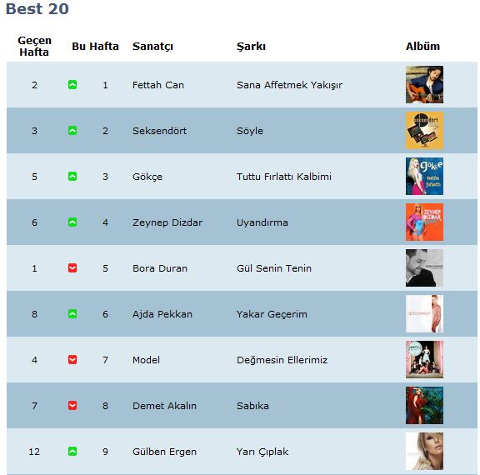
Optimization: Interleaving
Problem description
Solution
One more life for K/2 tag paths
Interleaving Detecting
Notes:
First is the interleaving problem. Look at this list, it is a typical example of interleaving lists. You see, the odd rows are light blue and the even ones are deep blue. In the basic algorithm, they are two different tag paths and will be filtered at the candidate check process. So our solution is to give those tag path one more chance. For those tag paths, we will check whether they are interleaved with each other. If so, I will merge them together.

Slide 23
Optimization: K+1
Here are the list:
1.Xxx
2.Xxx
…
…
K.XXX
1.Xxx
2.Xxx
…
…
K.XXX
Conclusion
Solution
One more life for K+1 tag paths
“Kick 1”
Notes:
Second is K+1 problem. Look at these two example, the left one has a head line which is "Here are the list" and the right one adds one conclusion line at the bottom. As a result, there are K+1 tags rather than K tags that share the same tag path. So our solution is to give another chance for these K+1 tag paths. And we need to "Kick 1" from them. We need to find the fake list items---this and this, and remove them

Slide 24
Optimization-tag path filtering
Filter tag paths of noise lists
Ads
Comments
Solution
Class/style blacklist
Notes:
The last one is tag path filtering. We can filter tag paths of some noise lists like advertisement and comments. We can keep a black list for the class and style attributes of tags. If a tag path contains the class or style in that black list. We will filter it.

Slide 25
Evaluation
System set up
Criteria
Experimental Result
Notes:
That is all for our approach. Now let's talk about the evaluation.

Slide 26
Evaluation: System Set Up
Test System
Benchmark
GoogleAPI
2*100 testcases
Notes:
First we built the testing systems in C# language. And we built two benchmarks using Google API. Each of the benchmarks contains one hundred top-k pages.

Slide 27


Evaluation: Criteria
Accuracy
Precision:
Recall:
Efficiency
Average Running Time(ms)
Notes:
In this evaluation, we use precision and recall to measure the accuracy. These are the definition of precision and recall
And we record the running time to measure the efficiency.

Slide 28
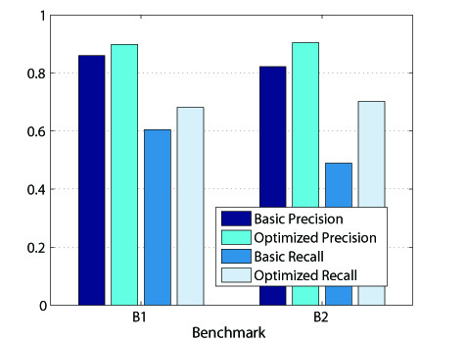
Evaluation: Experimental Result
Notes:
This is the experimental result. This and this are the precision and recall for the basic algo and this and this are for optimized system. As we can see from this figure. These optimizations really work. They improve both the precision and recall. This table shows the running time of the system. Each page only takes half a second. And most of time is used for IO and Parsing. So this system is quite effecient.

Slide 29
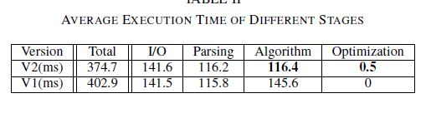
Evaluation: Experimental Result

Slide 30
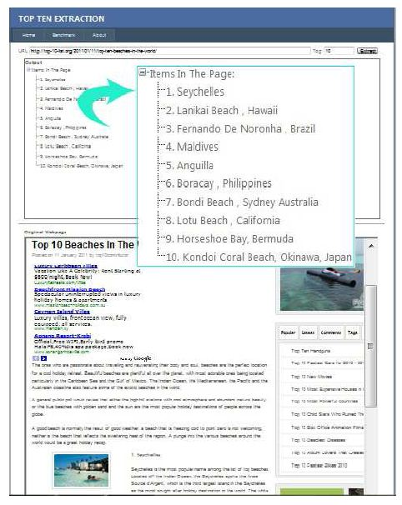
Demo Website
Default Mode
Benchmark Mode
Notes:
OK, this is our demo website. It looks like this.

Slide 31
Current Task
Analyze the title
Extract the item name
Further Improve the performace
Fix bugs
Notes:
Now let's talk about our current task.

Slide 32
Current Task: Analyze the title
Top-K Identificaiton
Info Extraction
K
Concept/Field
Direction
Restriction
How?
Machine learning(CRF)
Knowledge Base (ProBase)
Top 10 Tallest buildings in US
Notes:
First is to analyze the title.
We need to identify whether or not this page is a top-k page. And if it is, we need to extract useful information from the title, such as the number K the concept the direction and the restriction. For example, this title is of course a top-k page title. Its K is 10 and the concept is buildings the direction is tallest and the restriction is the location-in United States. Now we may use some machine learning methods to handle this task. And some knowledge base may be also useful.

Slide 33
Current Task: Extract the name
Seychelles
Lanikai Beach
Fernando De Noronha
…
…
Notes:
Another main task is to extract the name. For example, this is one list item that we get using the existing system. But actually what we really need is just the name of the item that is this part. So we should do further extraction to the results to get the exact name.

Slide 34
Further Reading
Wiki
Demo Paper: Automatic Extraction of Top-k Lists from the Web
Zhixian Zhang, Zheng Wang, Haixun Wang, Kenny Q. Zhu
Full size Paper (Draft)
Demo Website
Notes:
OK that is all of my talk. If you want to know more, you can visit our wiki site. You can have a look at our demo paper, but unfortunately this paper was just rejected by the ICDE yesterday. Now we are working at the full size paper, which contains more details about our algorithm, all these are available in our wiki. Also you can visit our demo site .

Slide 35
Related Work
“Webtables:Exploring the power of tables on the web,” in VLDB, 2008.
M. J. Cafarella et al.
Extracting data records from the web using tag path clustering
G. Miao et al.

Slide 36
Thank You!
You are very welcome to:
Share your idea.
Join us!
Email: zhangzhixian1989@gmail.com
Notes:
OK Thank you very much.
You are very welcome to share your idea, if you know some techniques that maybe useful for this project. Or if you are so interested in this project, you are very welcome to join us.
You guys can contact me through this email addr
Thank you!!

